Slide 1
MY INTRODUCTION
Full name : Md Noushad Bhuiyan
UCSC Login Name : Noushad97
Current Date: 4.14.2023

Slide 2

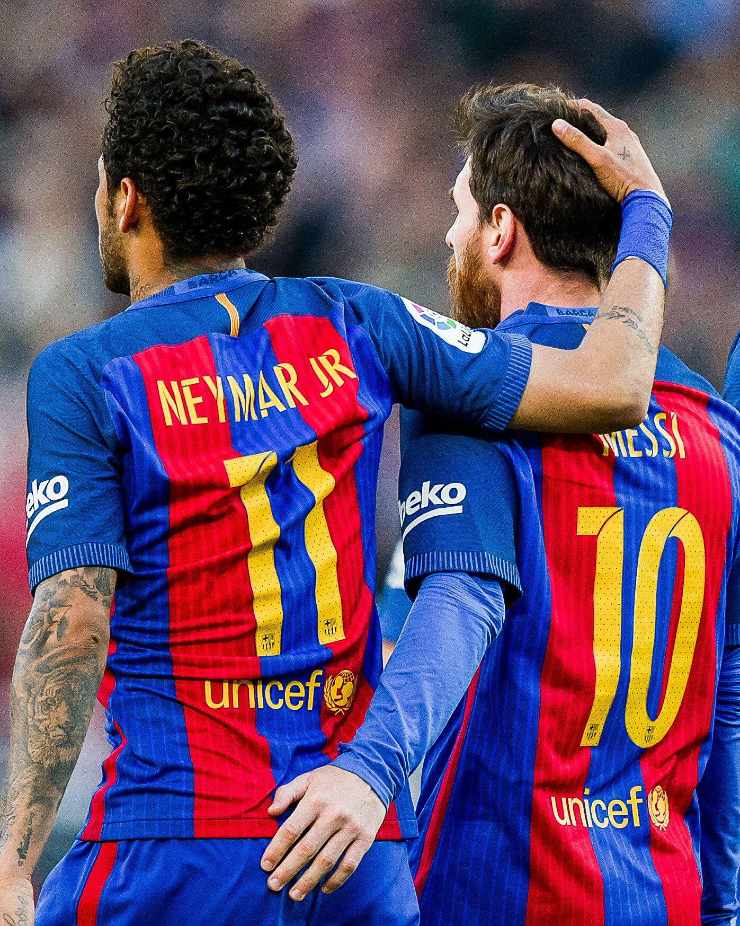
There are two great footballer named Messi and Neymar when they were in Barcelona.
They are unstoppable when they both play in Barcelona with luis Suarez. Those three footballer’s Trio was one of the best Trio of all time.

Slide 4
HerE is the first item of the list.
Here Is the second item of the list.
Here is the tHird item of the list.
Here is the fIrst Sub-bullet of the third item.
Here is the second sUb-bulleT of the third item.
Here is the fourth item of thE list.
Here is the first sub-bullet fOr the fourth item.
Here is the second sub-Bullet for the fourth item.
Here is the third sub-bulLet for the fouRth item.

Slide 5
4 Student’s CGPA in first semester Exam:
Name | Noushad | Basar | Fuad | Shahriar
Physics(CGPA) | 3.00 | 3.00 | 3.75 | 4.00
Chemistry(CGPA) | 3.15 | 3.00 | 4.00 | 3.5
CIT(CGPA) | 3.00 | 3.40 | 3.75 | 3.75
Math(CGPA) | 2.90 | 3.50 | 3.85 | 3.25
EEE(CGPA) | 3.00 | 3.75 | 3.50 | 3.00

Slide 6
Thank you Have A Good Day

